Slide 1
Navigating the New On Call List

Slide 2
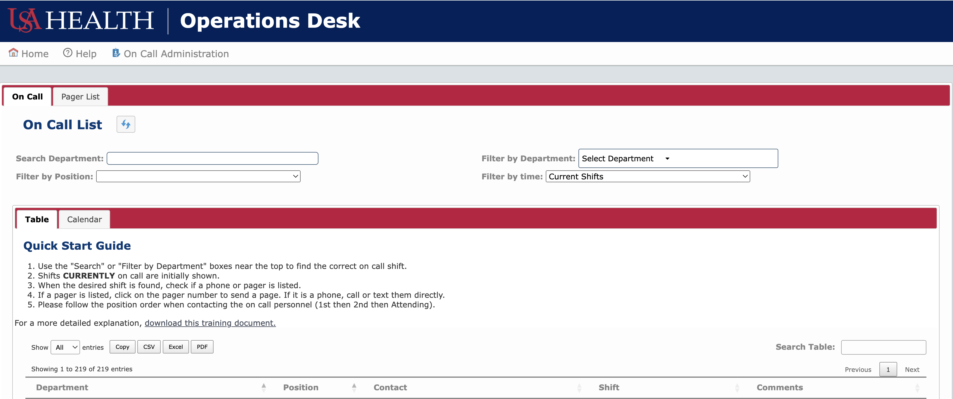
This is the On Call homepage.
You can find and contact On Call personnel directly from this page.

Slide 3
How to Find the Right Person

Slide 4
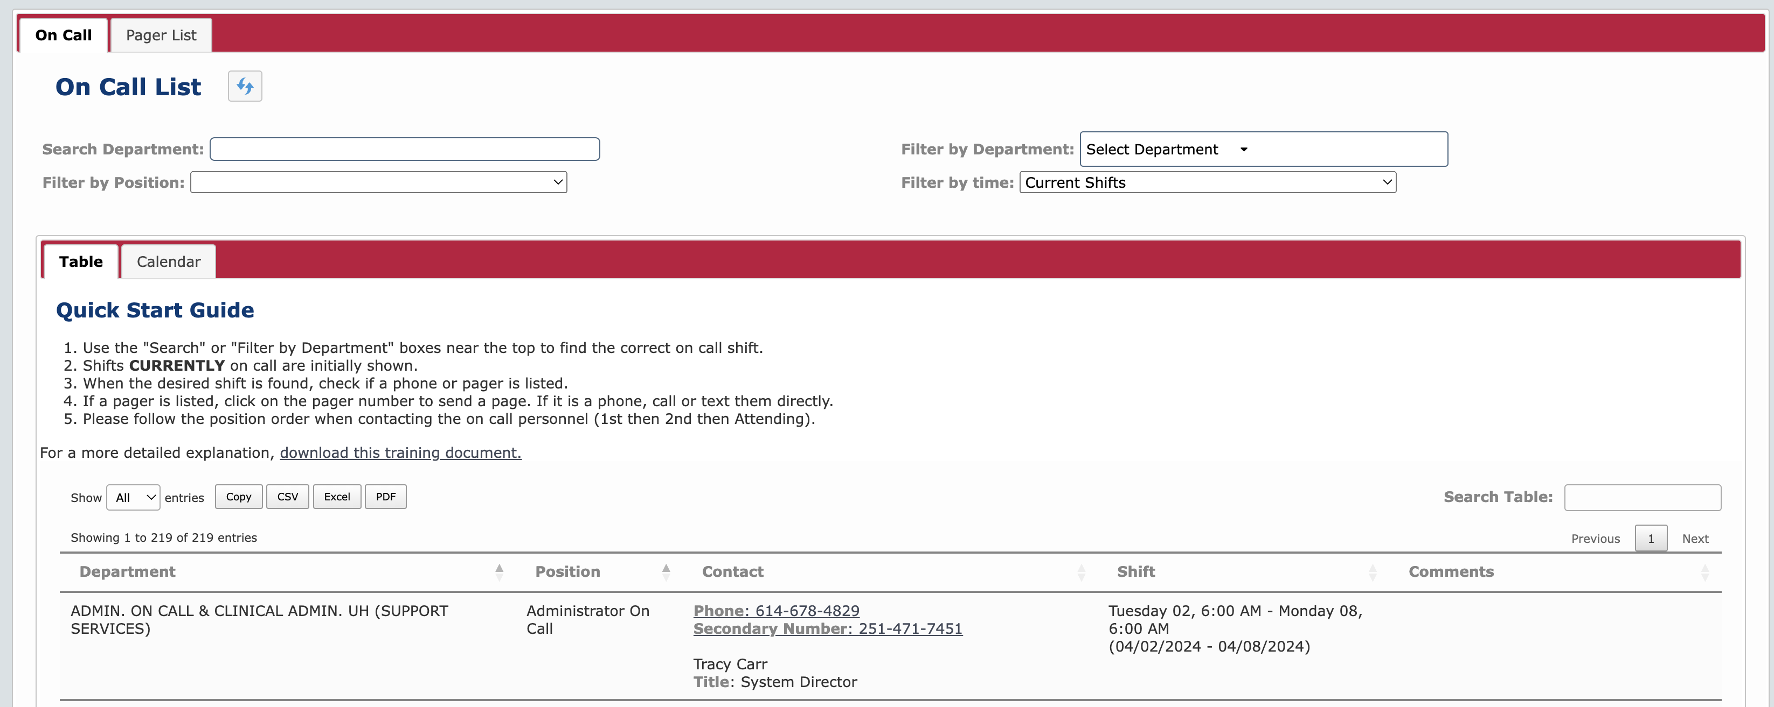
Use the “Search Department” box or click the “Filter by Department” box and select the department that you are searching for.
The list below will show the On Call shifts that are currently on duty.
Optionally: Click “Filter by Position” to better filter results.

Slide 5
Contacting the On Call Person From Within the Website

Slide 6
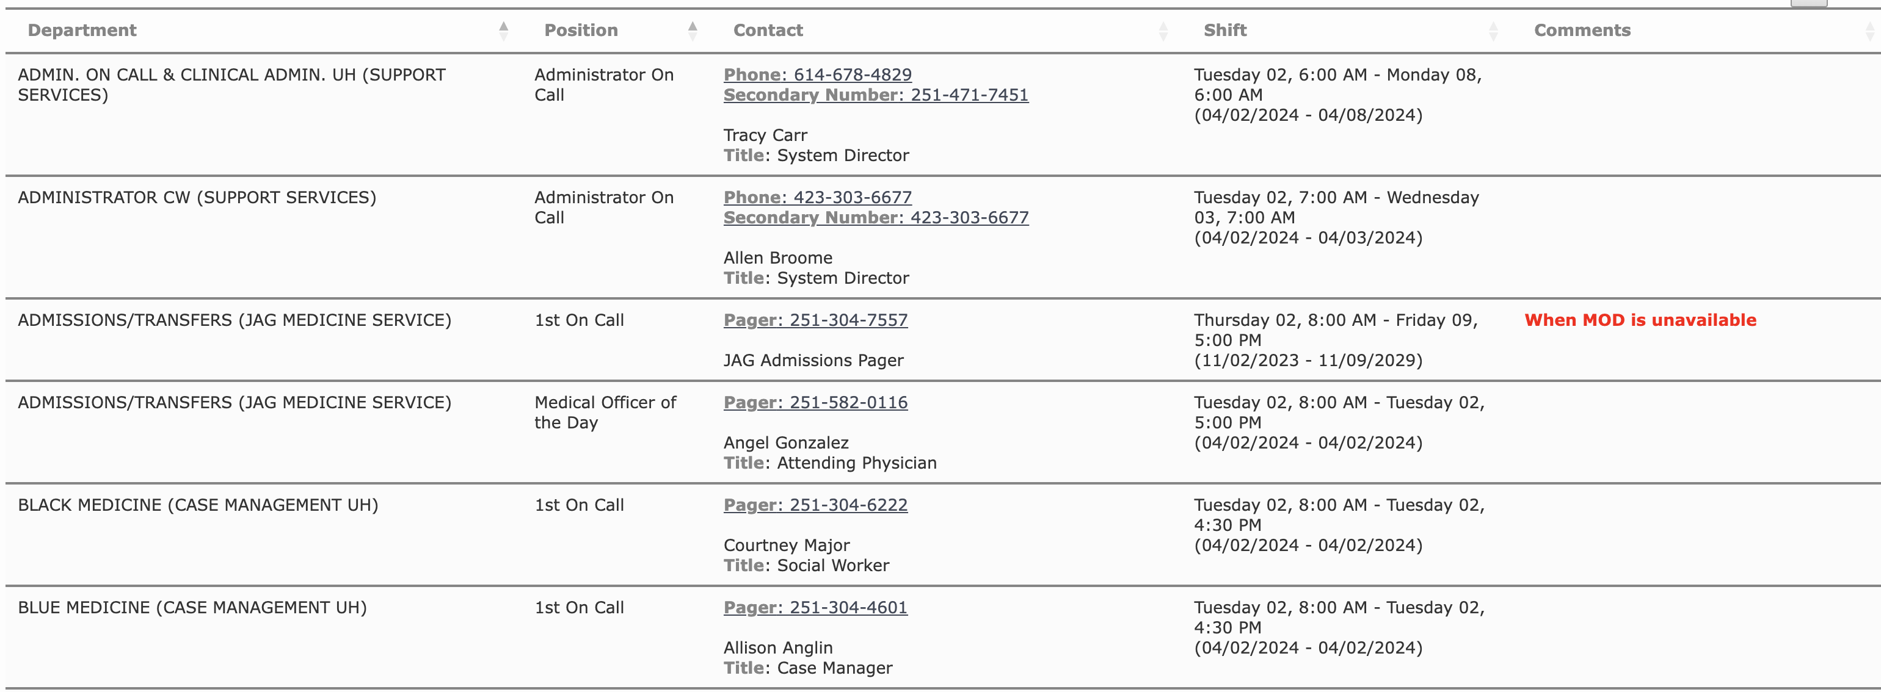
The “Contact” field has the contact information for each shift.
A shift might not have a name associated with it but will always have a contact number.
Pager – A pager message can be sent directly from the website. This will be shown next.
Phone – If a phone is listed call the number using your personal or office phone.

Slide 7
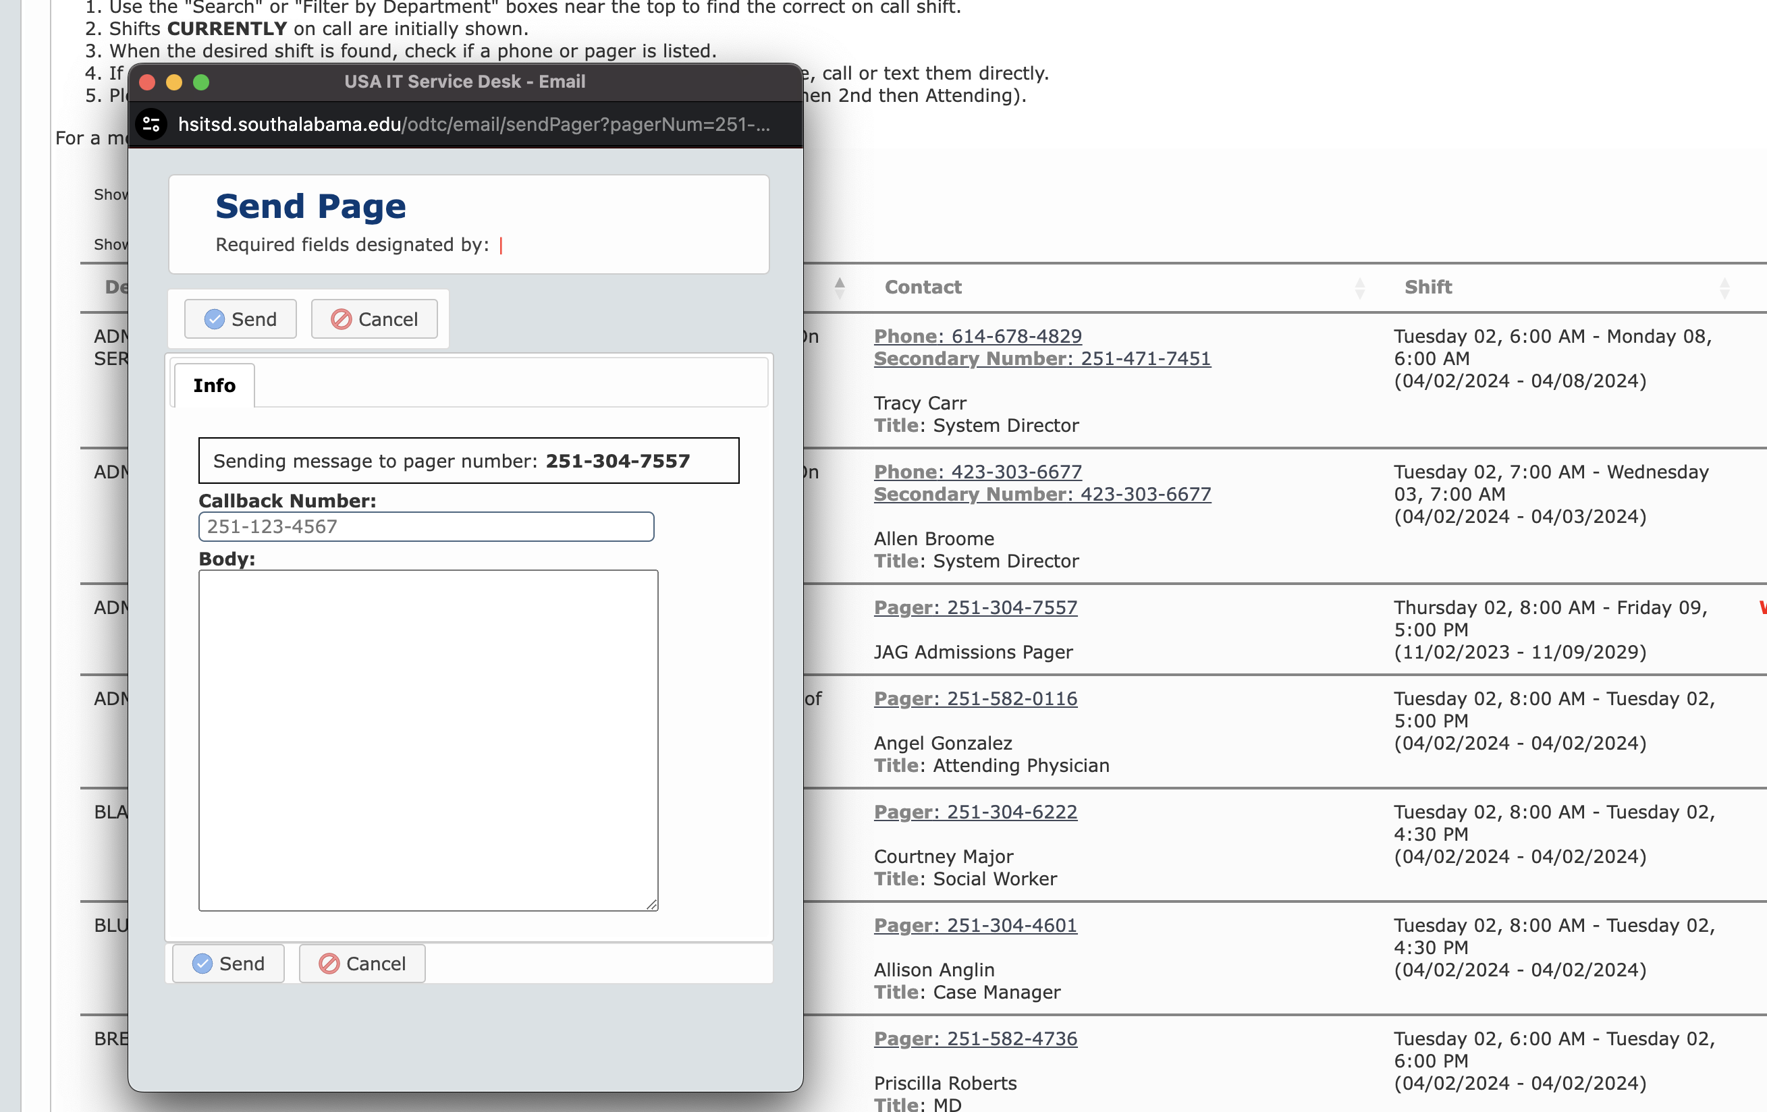
Click on the pager number and a window will open allowing you to send a pager message directly to that person.
In this new window you can type your message in the “Body” section.
You must include a number in the “Callback Number” box.
You can still send pager messages using other methods.

